Slide 1

Tomato leaf Diseases Detection using Raspberry pi

Slide 2
Some snapshots from the environment of the raspberry pi file manager

Slide 3
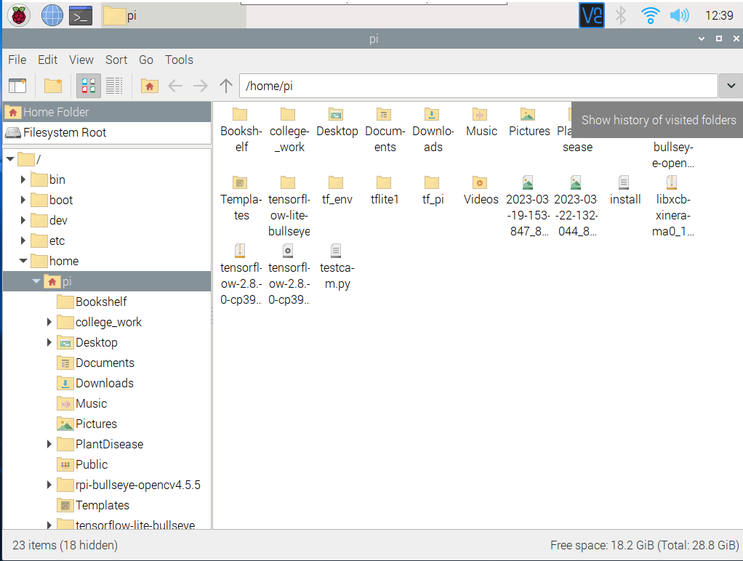

Slide 4
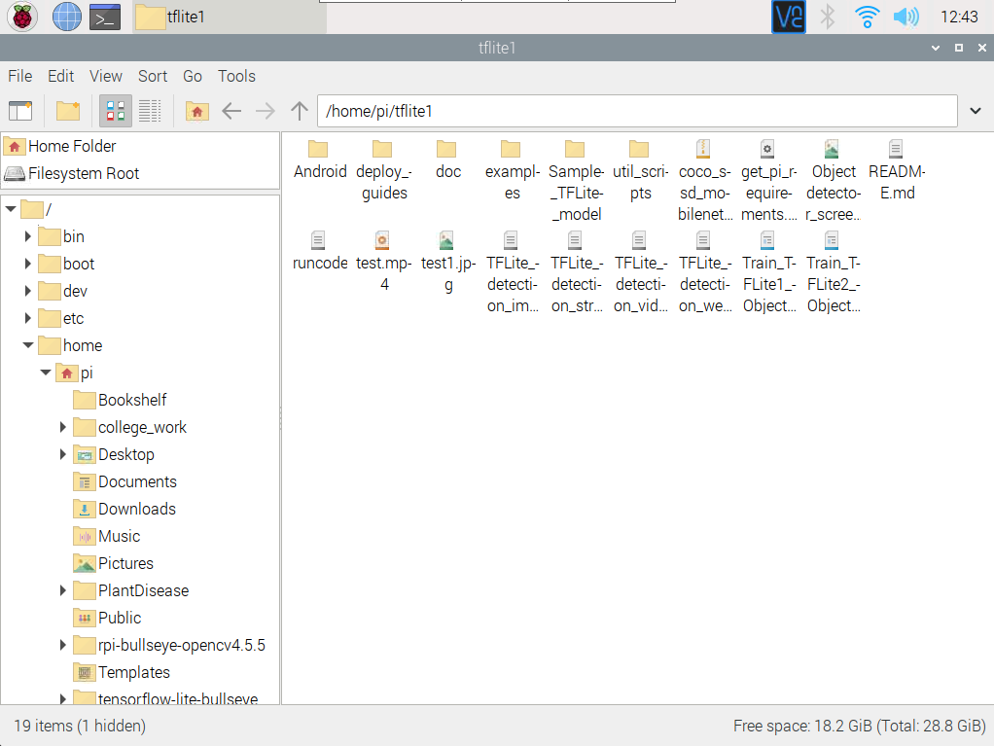

Slide 5
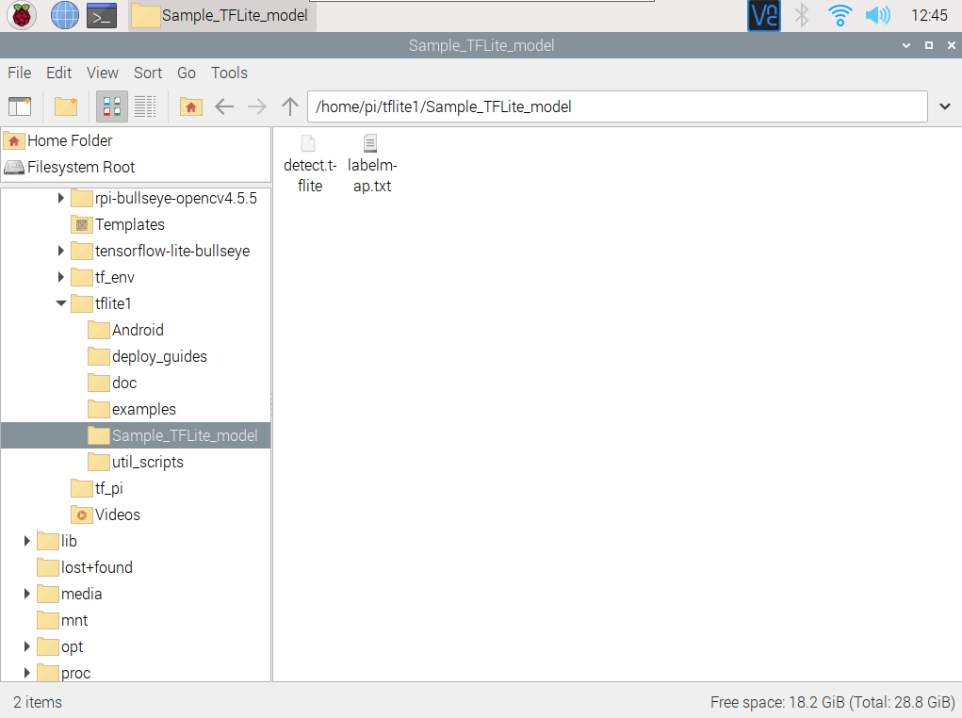

Slide 6
How to perform diseases detection

Slide 7
The following are the steps to perform diseases detection on raspberry pi 4
Power on the raspberry Pi (make sure there is attached keyboard, mouse, USB camera to the raspberry Pi and a display)

Slide 8
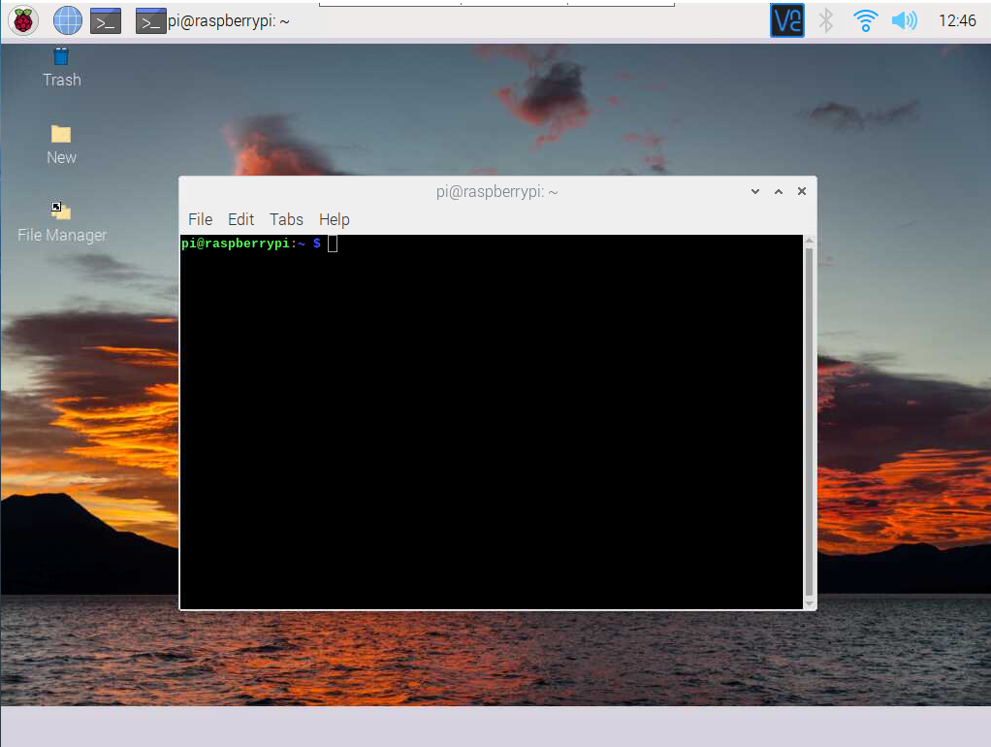
Open the terminal

Slide 9
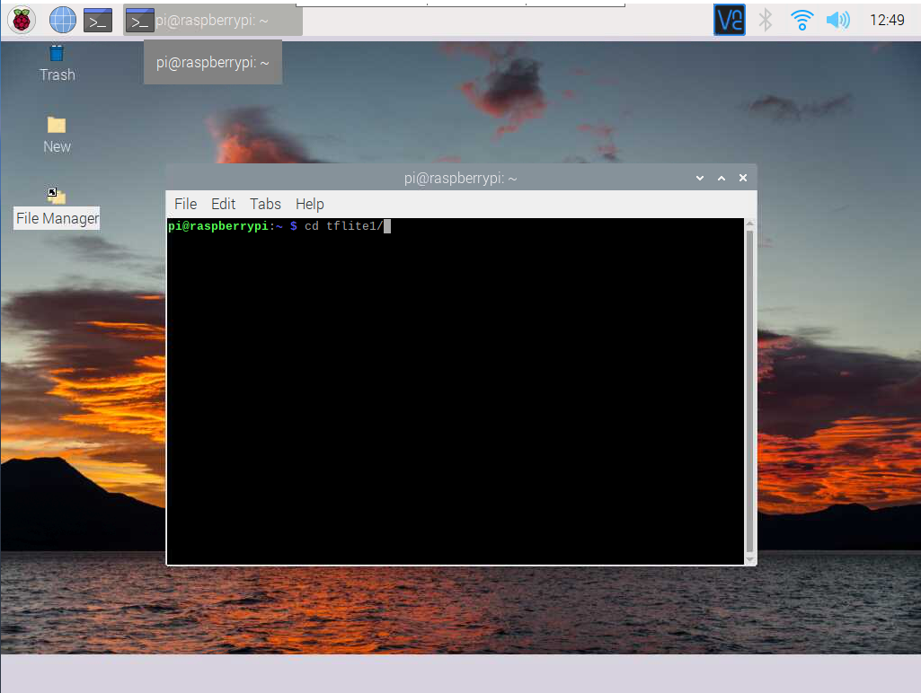
Change working directory to tfllite1
Type: cd tflite1/

Slide 10
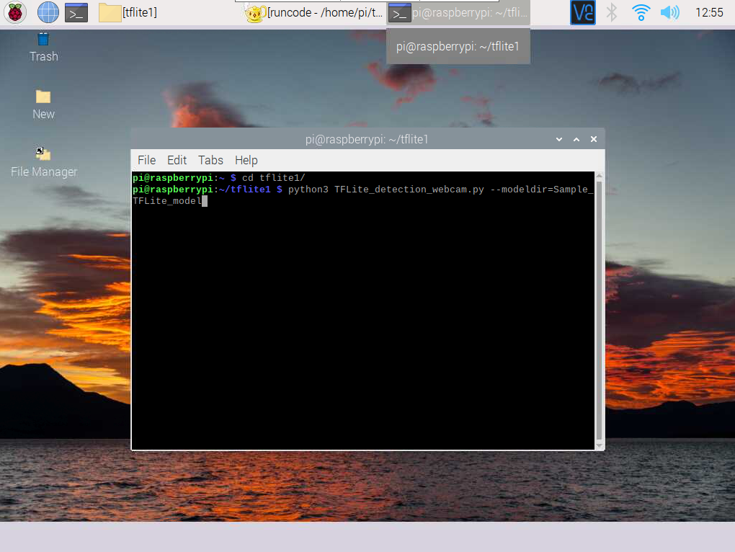
To run diseases detection using webcam
Type :
python3 TFLite_detection_webcam.py --modeldir=Sample_TFLite_model

Slide 11
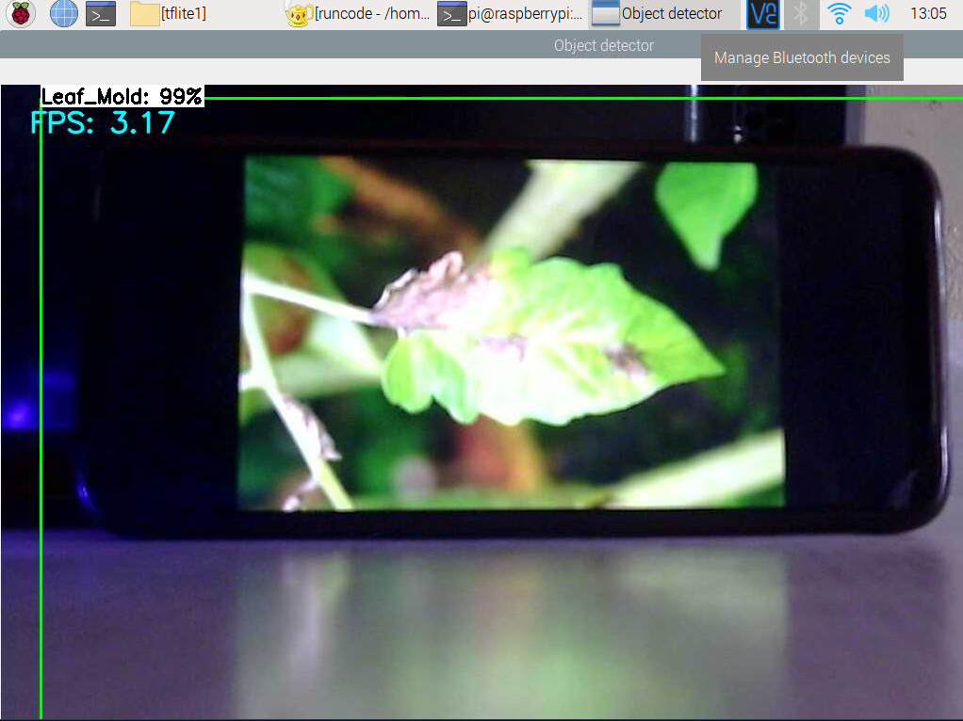
A window will appear shown below which detects the diseases as it starts

Slide 12
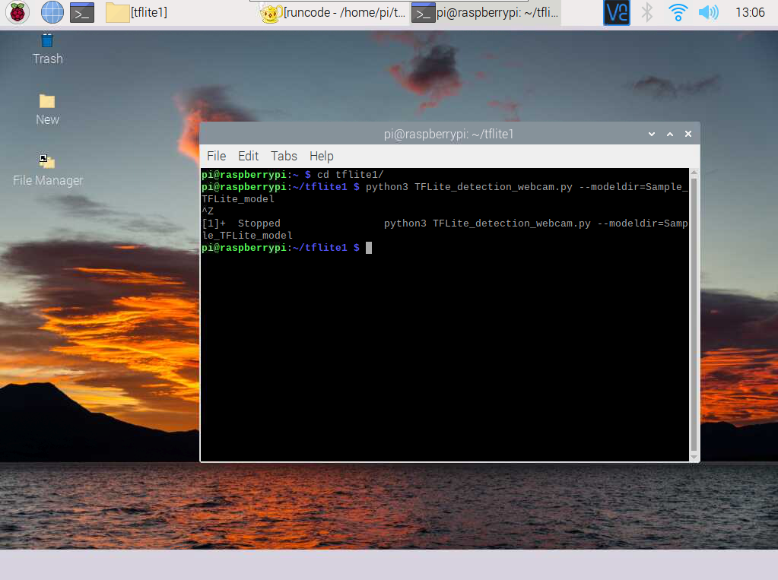
To stop the process manually, press Ctrl + z.

Slide 13
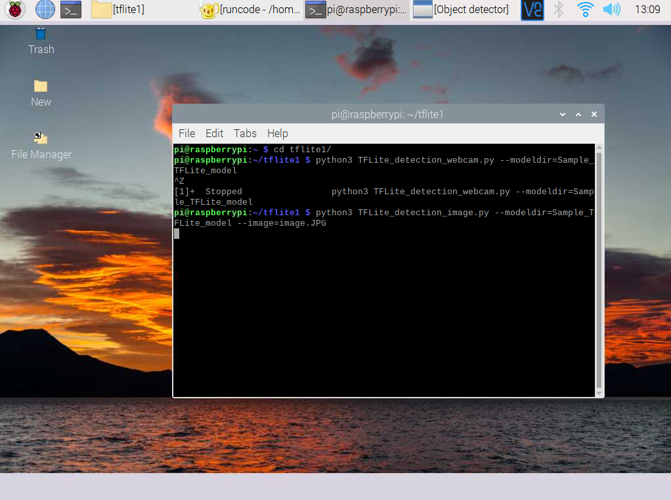
To perform diseases detection using single image
Type :
python3 TFLite_detection_image.py --modeldir=Sample_TFLite_model --image=image_name.JPG
(Note: Replace image_name.JPG with your image name)( Image location : tflite1/image.JPG)

Slide 14
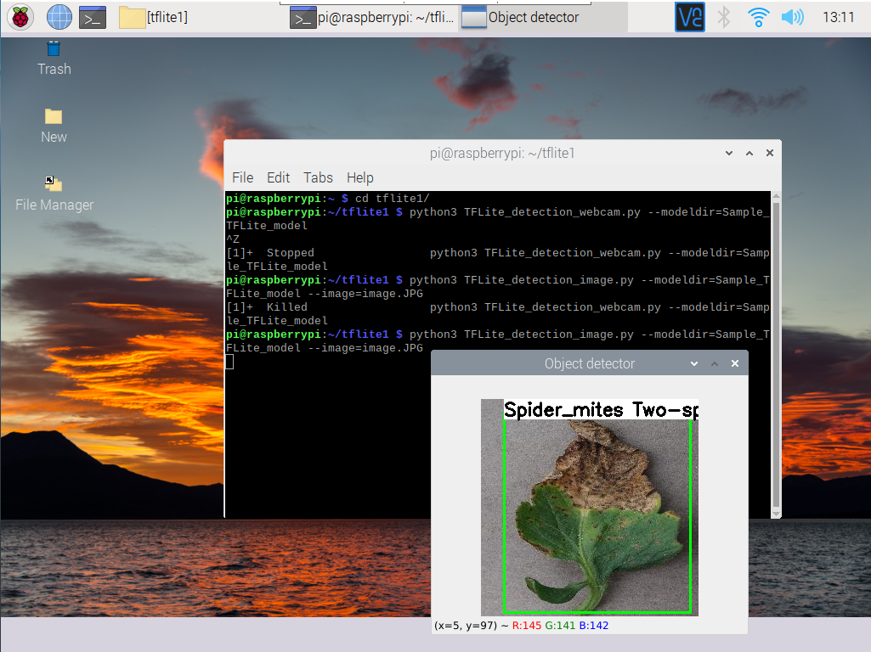
Result

Slide 15
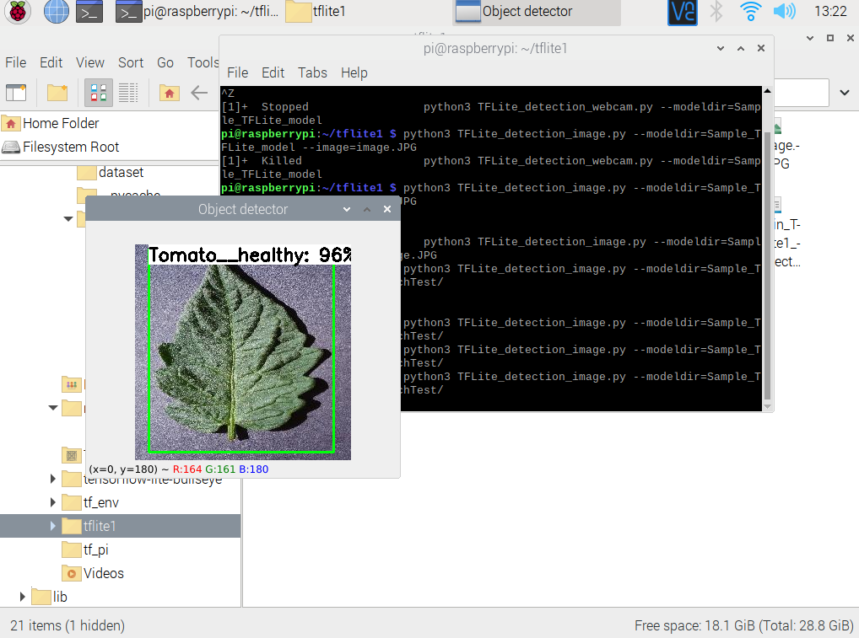
To perform multi image diseases detection.
Type:
python3 TFLite_detection_webcam.py --modeldir=Sample_TFLite_model --imagedir=“tflite1/image_folder_name/”
(Note: Rename image_folder_name with your folder containing test images)(image folder location: tflite1/image_folder)

Slide 16
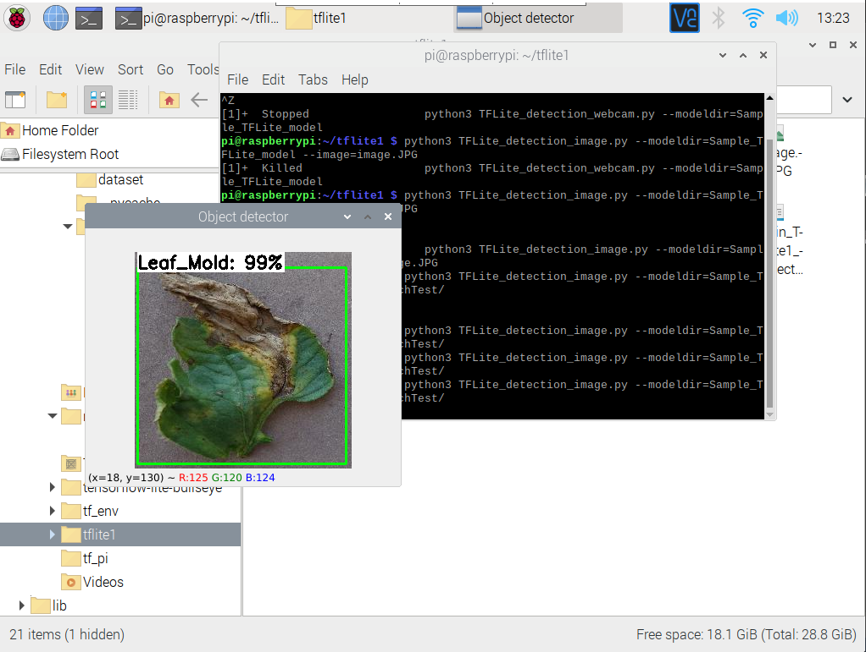
Press ENTER to see the next image

Slide 17
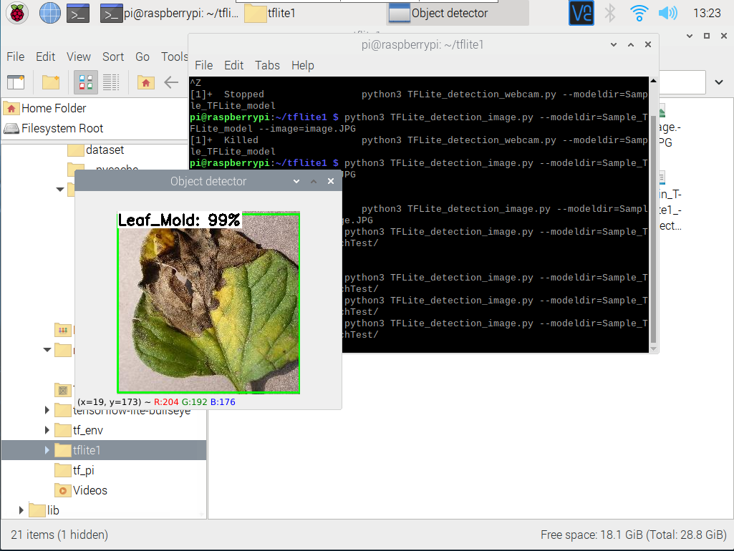
Press ENTER to see the next image

Slide 18
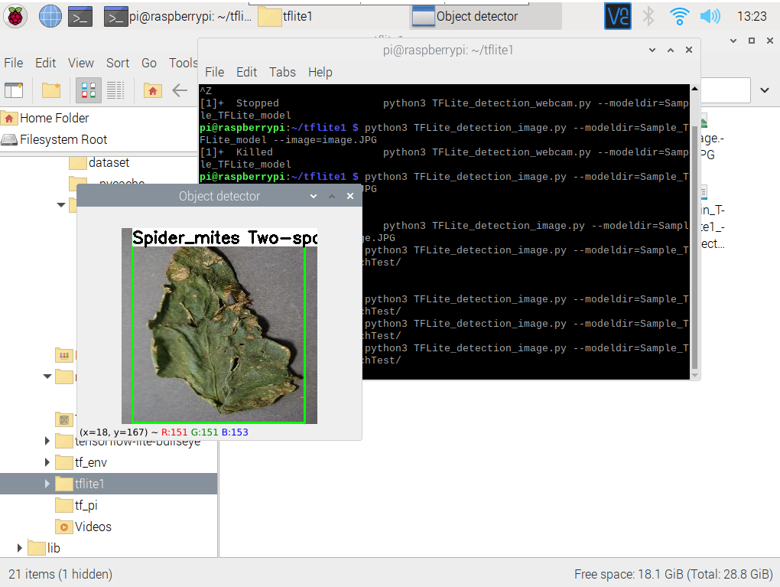
Press ENTER to see the next image

Slide 19
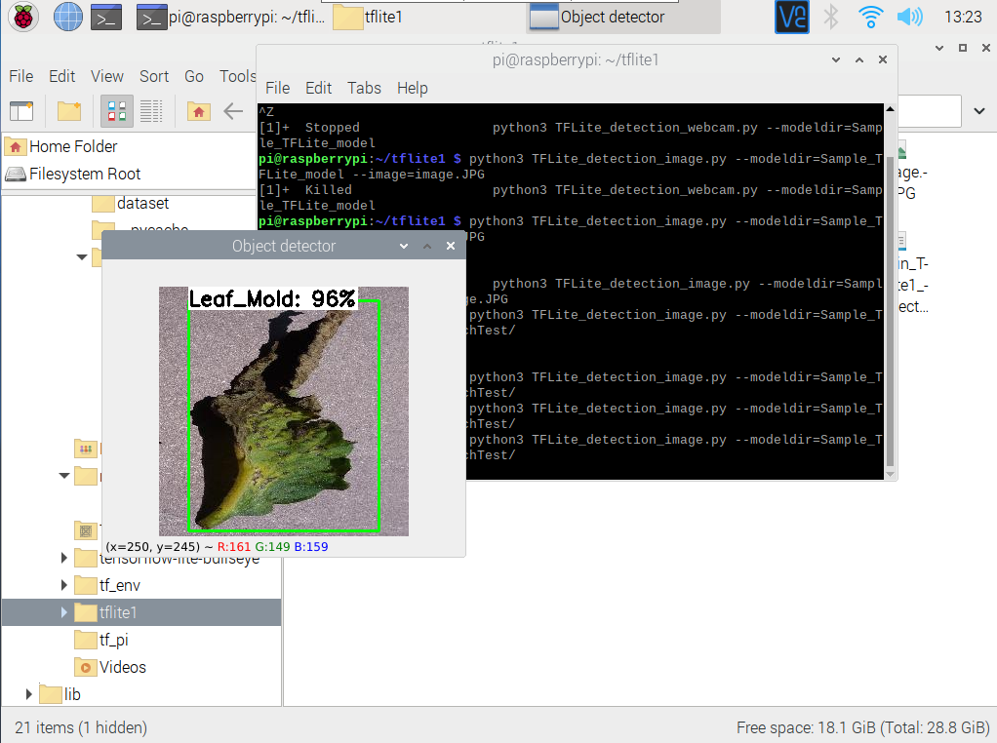

Slide 20
Some of the graphs generated while training the model

Slide 21
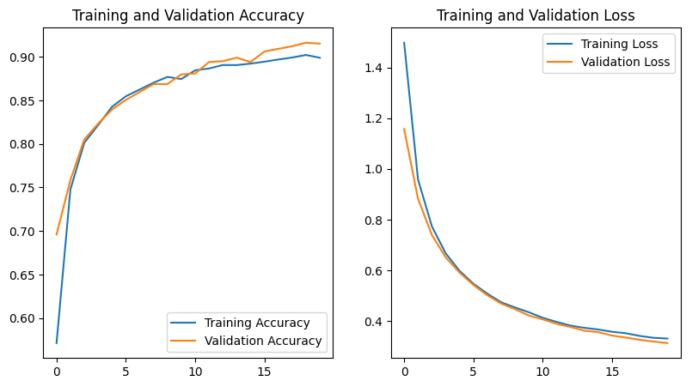

Slide 22
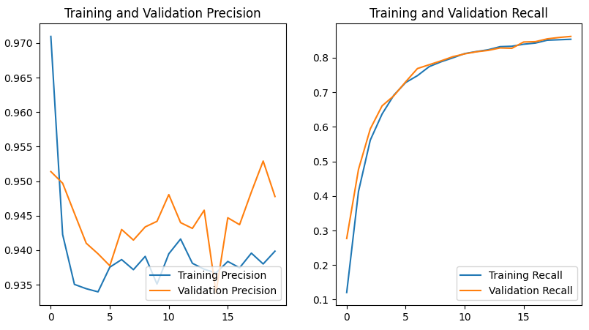

Slide 23
Tensorboard Graphs

Slide 24
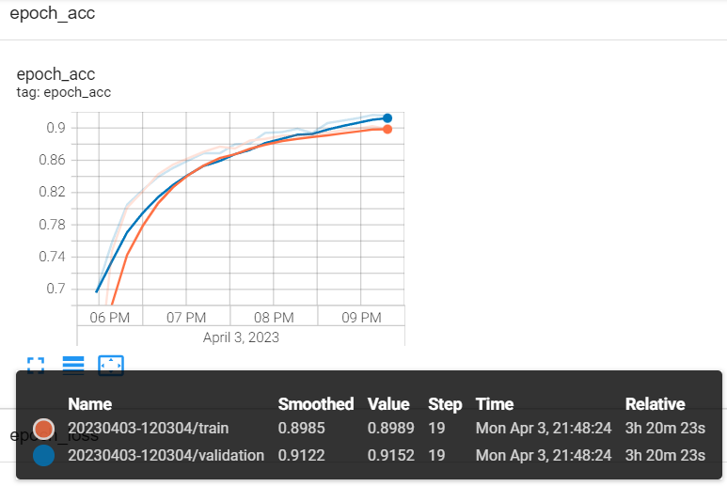

Slide 25
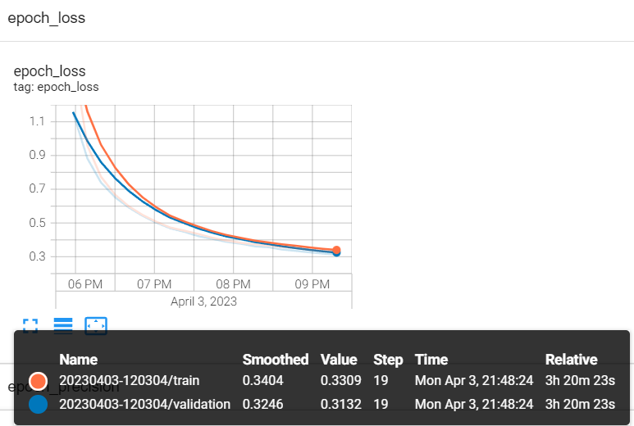

Slide 26
Predictions Results

Slide 27
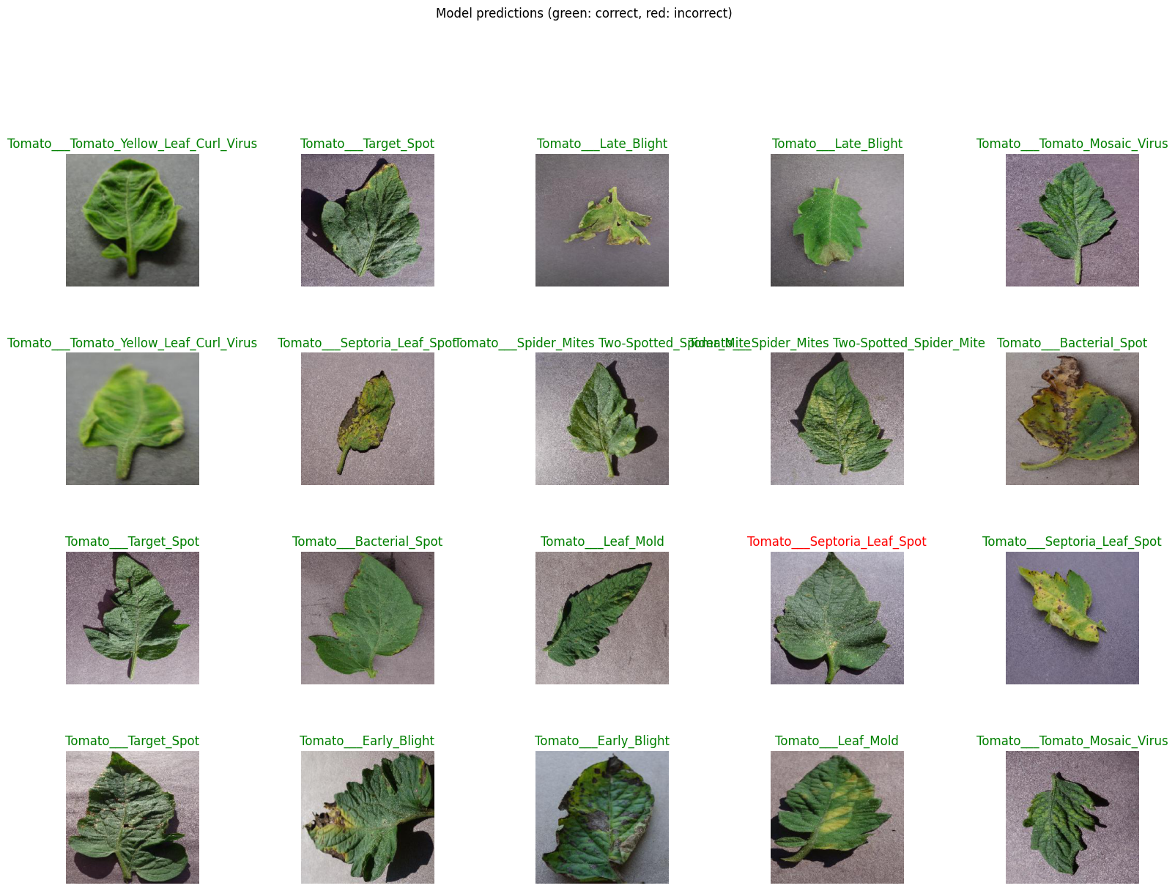

Slide 28
Thank you

